Slide 1


PROJECT PHASE 2

Slide 2







Team ID : LTVIP2023TMID10439
UNKILI JAYASRI
PANCHADI ANITHA

Slide 3



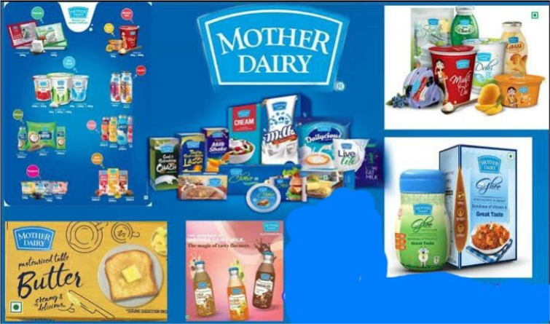
Mother dairy

Slide 4

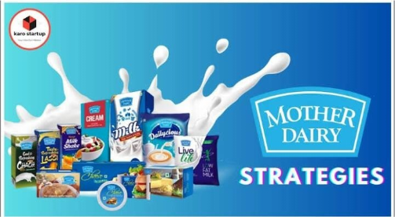
Part 1:Brand Study,Competitor Analysis £ Buyers Audience persona
Brand Study:

Slide 5
Mother Dairy is a well-known dairy company in India that offers a wide range of dairy products, including milk, yogurt, ice cream, and more.
They may conduct research to improve their product quality and develop new offerings, but I don't have access to specific information about their current research projects or any recent developments beyond my knowledge cutoff date in September 2021. You might want to visit their official website or contact them directly for the most up-to-date information on their research and products.
USP:
The USP of Mother Dairy is its quality and affordability of its products, which are sourced from co-operative dairies and farmers, providing them with fair prices.
Mother Dairy also offers a wide variety of products in different categories, such as milk, dairy products, fruits, vegetables, groceries, edible oil, beverages, frozen food, etc. under its popular subsidiary brands like Dhara, Safal, b-Activ, etc.Mother Dairy is also an , which ensures high standards of quality and safety. Mother Dairy is one of the leading brands in the food & beverages sector in India, with a turnover of around 11,000 crores as of the year 2020

Slide 6

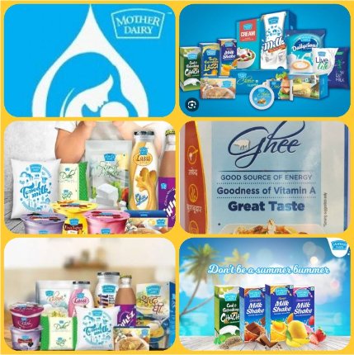
Mother Dairy is a well-known brand of milk and dairy products in India. It was established in 1974 as a subsidiary of the National Dairy Development Board (NDDB) under the Operation Flood program, which aimed to make India self-sufficient in milk production.
Mother Dairy has a diversified product portfolio, which includes milk, milk products, ice cream, paneer, cheese, butter, ghee, edible oil, fruit juices, jams, pickles, and fresh fruits and vegetables. It sells its products under three brand names: Mother Dairy, Safal, and Dhara. Mother Dairy is the brand name for all its milk and milk products, Safal is the brand name for its fruit and vegetable arm, and Dhara is the brand name for its edible oil segment. Mother Dairy also operates retail outlets and booths across the country, where it sells its products directly to consumers.

Slide 7

Mother Dairy : Mission & Value mother Dairy, an Indian dairy company, has a mission and set of values that guide its operations. As of my last knowledge update in September 2021, their mission and values may include
Mother Dairy's mission is to provide safe, quality, and nutritious dairyproducts to consumers while promoting the welfare of farmers and maintaining environmental sustainability.
Quality: Mother Dairy is committed to ensuring the highest quality in its dairy products.
Integrity: They operate with integrity and transparency in all their dealings. 3.Customer-Centric: Mother Dairy focuses on meeting customer needs and delivering customer satisfaction.
Sustainability: The company values sustainable and environmentally responsible practices in its operations.
Farmer Welfare: Supporting and improving the livelihoods of dairy farmers is a fundamental value.

Slide 8



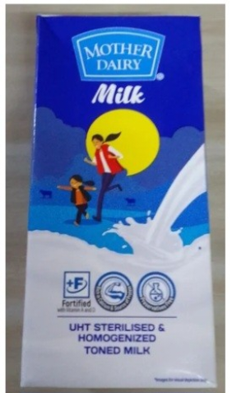
Quality Assurance: Mother Dairy is known for its strict quality control measures. They maintain high-quality standards in the production of dairy products, assuring customers of safe and nutritious options.
Farm-to-Table Approach: The company often
highlights its farm-to-table approach, ensuring that the dairy products are sourced directly from dairy farmers. This emphasis on the freshness and sourcing of their products differentiates them from competitors.

Slide 9

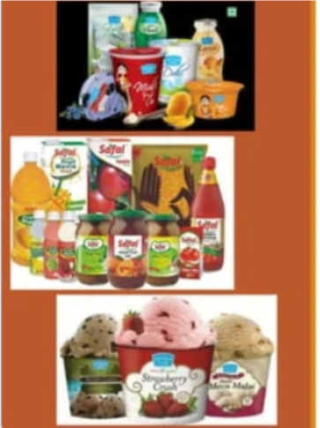
Farmer Welfare: Mother Dairy's commitment to the welfare of dairy farmers is a unique aspect of their brand. They work closely with local farmers, offering them support and fair pricing, which resonates with socially conscious consumers.
Environmental Sustainability: The brand's focus on environmental sustainability is another distinguishing feature. Mother Dairy often promotes eco-friendly practices in its operations, appealing to consumers concerned about sustainability.
Local and Traditional: Mother Dairy's products often emphasize traditional and local flavors, which can be a unique selling point in a diverse and culturally rich country like India.
Trust and Reliability: Mother Dairy has established trust and reliability over the years, making it a preferred choice for consumers looking for consistent and safe dairy products.

Slide 10

❖
Mother Dairy is known for its trustworthy and wholesome image, offering a wide range of dairy products. The brand tone for Mother Dairy is typically friendly, reliable, and
family-oriented, emphasizing the goodness of their products and their commit

Slide 11
brand identity:
-

Slide 12
Goal: Speciﬁc: Increase market share in the dairy industry by 5% within the next ﬁscal year
KPI: Sales Growth Rate: Measure the percentage increase in sales revenue for Mother Dairy products on a monthly and quarterly basis.
Goal: Measurable: Achieve a 10% growth in sales revenue for dairy products in the next quarter.
KPI: Market Share: Track the company's market share compared to competitors on a quarterly basis.
Goal: Achievable: Expand distribution to 200 more locations in the current year.
Customer Satisfaction Score (CSAT): Regularly assess and track customer satisfaction through surveys and feedback.
KPI: Relevant: Enhance customer satisfaction ratings by 15% through improved product quality and customer service.
Goal: Distribution Expansion: Monitor the number of new retail locations added each quarter.
KPI: Quality Control: Track the number of product recalls and customer complaints related to product quality.
Goal: Time-bound: Launch two new dairy products within the next six months.

Slide 13

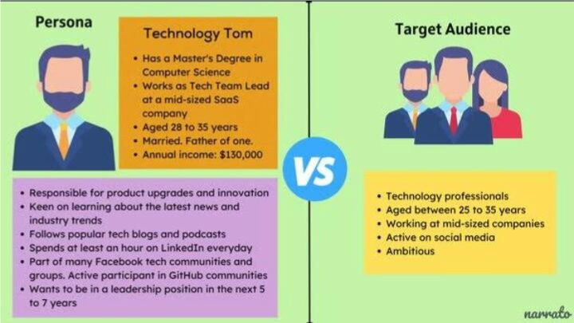

Slide 14

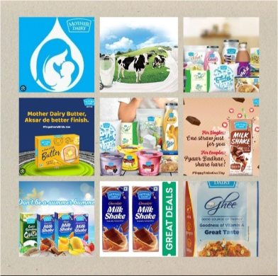

Demographic
Psychotropic
Interests
❖
Age : Primarily families with children, including
parents aged 25-50.
Gender: Both male and female, but skewing slightly towards females as they often make household dairy purchase decisions.
Income : Middle to upper-middle-income households.

Slide 15
Location: Urban and semi-urban areas in India.
Education: Typically, people with at least a high school education.
Family size: Families with two or more members.
Psychographic:
Lifestyle: Health-conscious individuals who prioritize nutrition and well-being.
Values: Those who value quality and trustworthiness in their dairy products.
Behavior: Regular consumers of dairy products like milk, yogurt, and dairy-based snacks.
Environmental awareness: Consumers concerned about sustainable and eco-friendly practices.
Interests:
Healthy living: People interested in maintaining a healthy lifestyle through diet and exercise.
Cooking and nutrition: Individuals who enjoy cooking and are interested in using dairy products in their recipes.

Slide 16
❖
Mother Dairy Competitors:
Amul: Amul is one of the largest and most well-known dairy cooperatives in
India, offering a wide range of dairy products, including milk, butter, cheese, and
Nestlé: Nestlé, a global food and beverage company, competes with Mother
more.
Dairy in the dairy product segment with brands like Nestlé A+ and Nestlé Milkmaid.
Britannia: Britannia Industries, a prominent Indian food company, produces
dairy products such as cheese, butter, and dairy-based snacks, competing with
Parag Milk Foods: This company offers dairy products under the brand name "Gowardhan" and competes with Mother Dairy in the milk and dairy product
Kwality: Kwality is another dairy company in India that offers a range of milk
Mother Dairy in these categories.
market.
and dairy products, posing competition to Mother Dairy.
Gopaljee: Gopaljee is known for its dairy products, including milk, ghee, and
more, and competes with Mother Dairy in the dairy industry

Slide 17


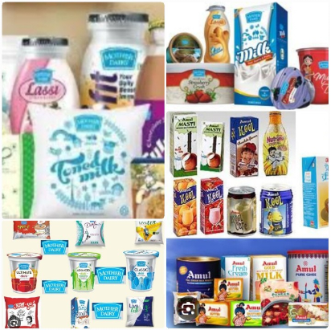
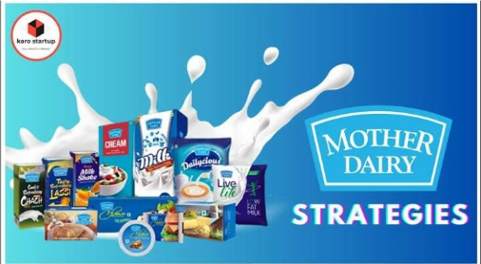
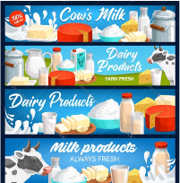
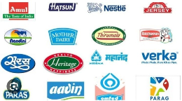

Slide 18


Competitors Analysis:
•
Britania commitment to quality, freshness, and ethical practices, along with its wide product range, positions it as a leading and trustworthy brand in the Indian dairy market.
•
Britania well-known dairy company, likely engages in online communication through its website, social media channels, and email marketing. Their online presence allows them to share product information, promotions, recipes, and engage with customers for feedback and inquiries. Online communication helps companies like britania Dairy connect with their audience and provide valuable content and support in the digital space.
•
❖
Britania has a well-established and trusted brand name in the dairy
industry.
It offers a wide range of dairy products, including milk, yogurt, ice cream, and mor
britania an extensive distribution network, ensuring its products reach a large consumer base

Slide 19


❖
Milk production is highly seasonal, which can affect production planning and supply
Faces strong competition from both local and multinational dairy companies.
Consumers are price-sensitive when it comes to dairy products, which can impact profitability.
Dependence on Agricultural Practices: Vulnerable to fluctuations in crop and fodder
production, which can affect dairy production.
chain management.
❖
Increasing consumer focus on health and wellness can be leveraged to promote dairy products as a source of nutrition.
Introduce new dairy products and flavors to cater to changing consumer
preferences.
❖
Vulnerable to fluctuations in milk prices and input costs.
Changes in government regulations and policies can impact the dairy industry.
Growing health concerns and dietary shifts might affect the consumption of dairy products.

Slide 20


❖
Amul's USP is often associated with its cooperative structure and the "Amul Girl" mascot, which has been a symbol of the brand for decades.
Amul is known for its wide range of dairy products, including milk, butter, cheese, and
ice cream, and it's often seen as a symbol of quality and taste.
❖
Online communication is essential for brands like Amul and Mother Dairy to connect with consumers, promote their products, and provide updates and information. They can use websites, social media platforms, email marketing, and mobile apps to engage with their audience, share product details, run promotions, and address customer inquiries. This digital presence helps them stay competitive and build a stronger brand image.
❖

Slide 21



❖
Amul is a well-established and trusted brand in India with a strong presence.
It offers a wide range of dairy products, from milk to butter, cheese, and ice cream.
It operates on a cooperative model, involving millions of farmers, which ensures a consistent milk supply.
❖
Primarily known in India, Amul has limited international presence.
Competition: Faces intense competition
Faces intense competition from other dairy brands, both local and international.
❖
There's potential to expand its footprint in international markets.
Health-Conscious Consumers: The growing trend towards health and wellness opens up opportunities for healthier dairy products.
❖
Rivalry with brands like Mother Dairy, Nestle, and local competitors can impact market share.

Slide 22


❖
Nestlé, a multinational food and beverage company, has a diverse product portfolio, including brands like Nestlé Pure Life, Nescafé, KitKat, and many more. Their USP often revolves around product quality, taste, and convenience. They emphasize quality and innovation in their products.
❖
Nestlé is a global food and beverage company, and its online communication strategies are comprehensive. Here's how Nestlé typically manages online communication
Online communication for a brand like Mother Dairy, a popular dairy company, would typically involve various digital marketing strategies.
❖
❖
It is a well-known and trusted brand in the dairy industry with a strong presence in India.

Slide 23


❖
Faces stiff competition from local and multinational dairy brands in India.
Dairy products are price-sensitive, and fluctuations in milk prices can affect the company's margins.
Ensuring a consistent supply of fresh dairy products can be challenging, especially in a diverse country like India.
❖
Health and Wellness Trend: Growing consumer awareness of health and wellness can lead to increased demand for healthier dairy products.
Product Diversification: Expanding the product line to include more value-added dairy products or dairy alternatives can capture new markets.
❖
Milk Price Fluctuations: Dependence on the dairy farmers for milk supply can expose the company to price volatility and supply chain risks.
Regulatory Changes: Changes in government regulations regarding food safety and labeling can impact the business.

Slide 24





Slide 25
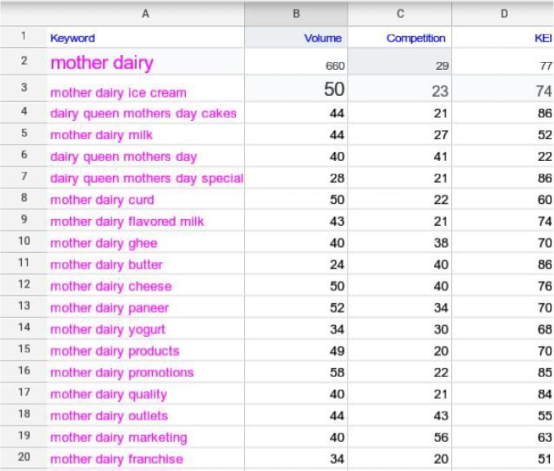

Slide 26
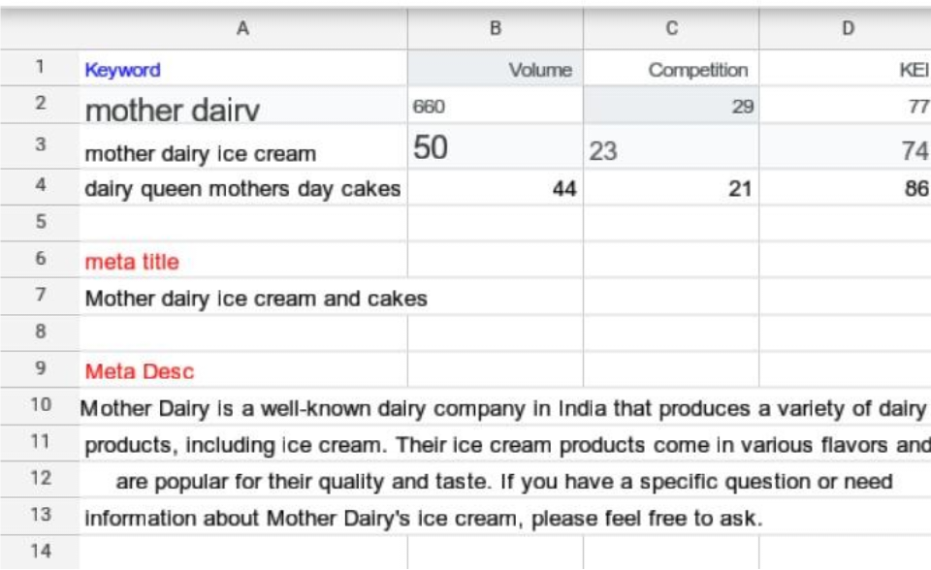

Slide 27
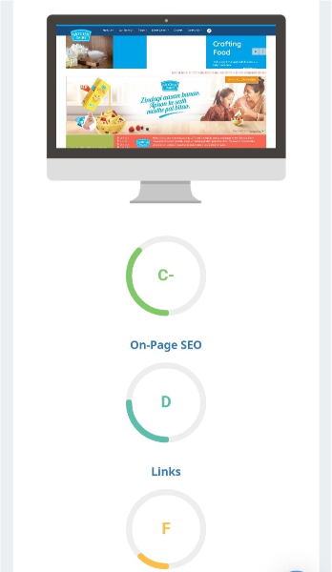
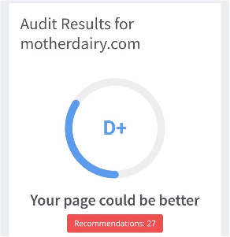
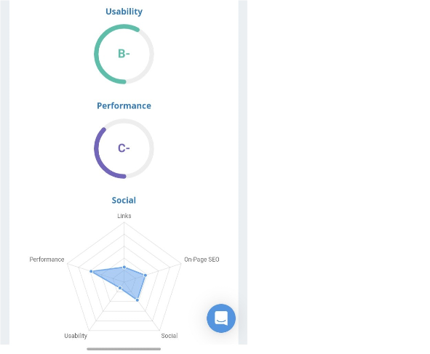

Slide 28
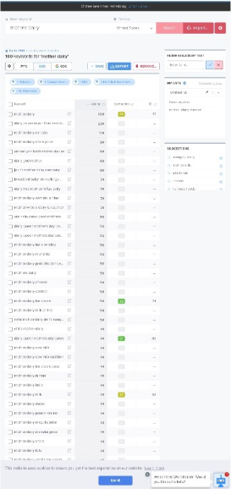

Slide 29
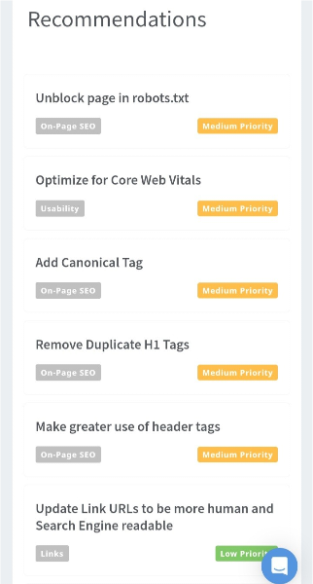
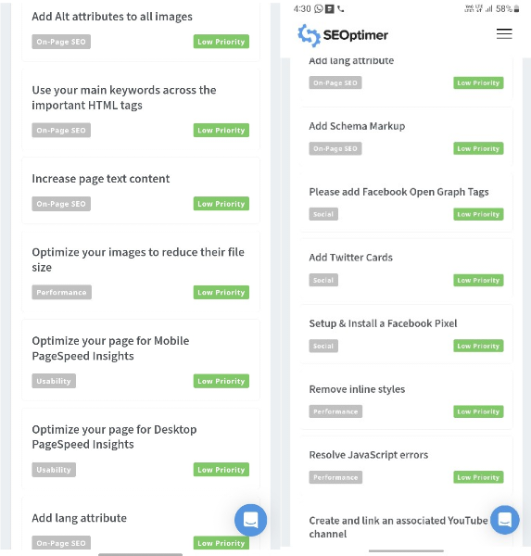

Slide 30
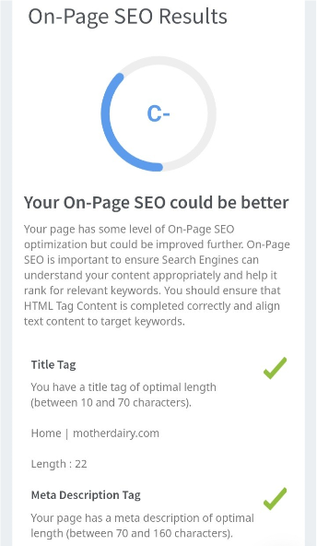
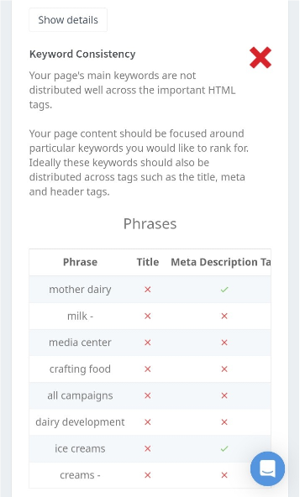

Slide 31
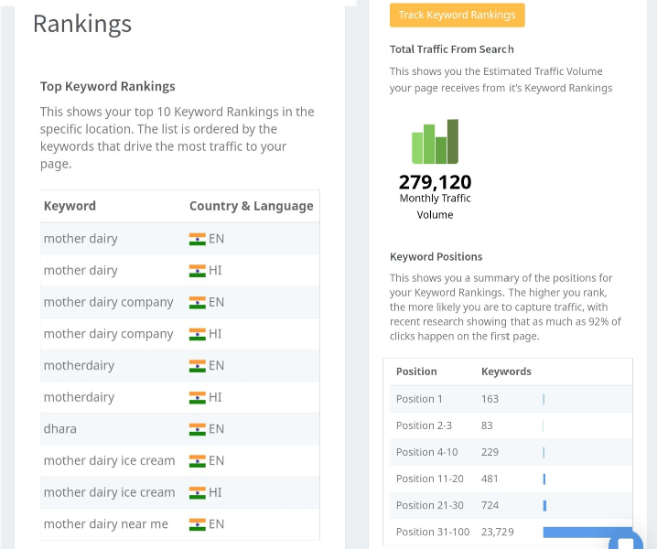

Slide 32
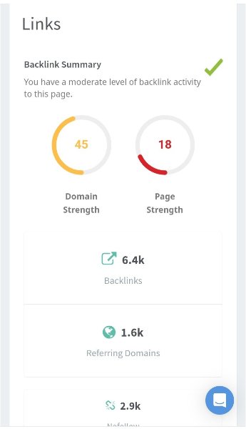
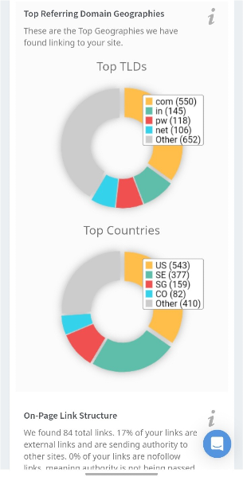

Slide 33
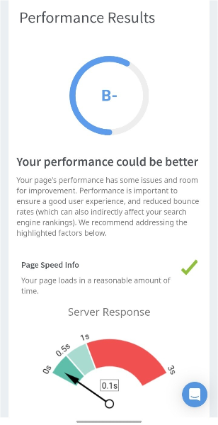
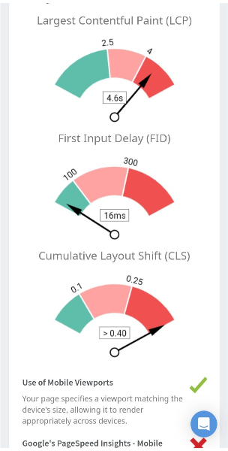

Slide 34
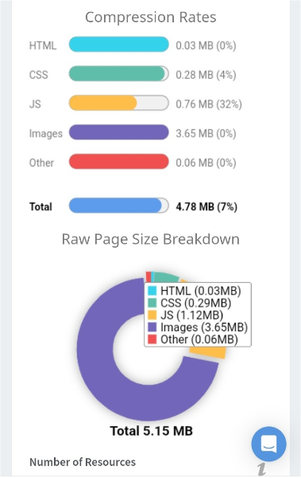
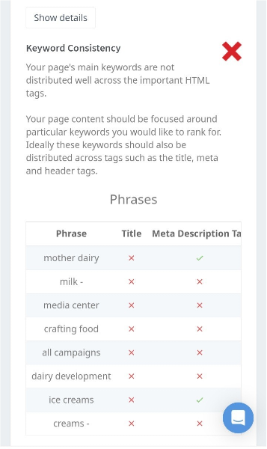
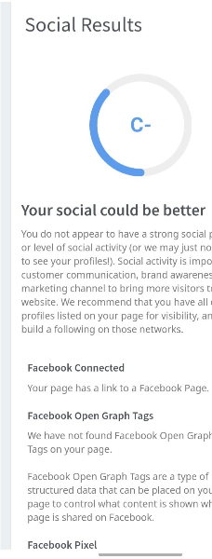

Slide 35



Slide 36


October 16 | Dairy Health | Blog Post | Facebook | Educate on dairy benefits
October18 | Recipe Showcase | Video | Instagram | Showcase dairy recipes
October21 | Sustainability | Infographic | Facebook | Highlight eco-friendly
October 25 | Dairy Myths | Podcast | Instagram | Bust common myths about
October 28 | Nutritional Tips | Interactive | Facebook | Engage audience with a
October30 | Halloween Fun | Instagram | Instagram | Share fun Halloween-theme d

Slide 37
Content Ideas:
Recipe Videos: Create engaging videos featuring recipes using Mother Dairy products like milk, paneer, yogurt, and more. Share these on social media and your website to inspire and educate your audience.
Health and Nutrition Blog: Start a blog discussing the health benefits of dairy products, nutrition tips, and how Mother Dairy products fit into a balanced diet.
Marketing Strategies:
Social Media Campaigns: Use platforms like Instagram, Facebook, and Twitter to run engaging campaigns, including contests, giveaways, and user-generated content initiatives.
Influencer Collaborations: Partner with food and nutrition influencers to promote your products through authentic reviews and recipe demonstrations.
Educational Webinars: Host webinars or live sessions with nutritionists and chefs to discuss the benefits of dairy and offer cooking tips.

Slide 38

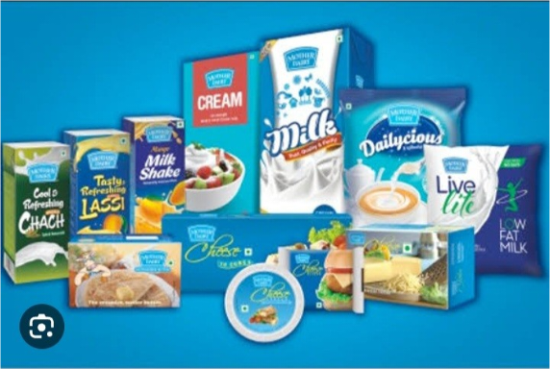
❖

Slide 39


•
Product Highlights: Create posts, images, or videos featuring different Mother Dairy products like milk, yogurt, and cheese. Highlight their quality, taste, and nutritional value.
Recipe Ideas: Share recipes that incorporate Mother Dairy products as ingredients. This can include smoothies, desserts, and savory dishes.
Health Benefits: Educate the audience on the health benefits of consuming dairy products and how they fit into a balanced diet.
Farm-to-Table Stories: Share the journey of Mother Dairy's products from the farm to the consumer, emphasizing freshness and sustainability.
Educational Content: Create informative posts about dairy farming practices, nutritional facts, and storage tips.
Engage with Trends: Stay up-to-date with social media trends and incorporate them into your content to keep it relevant and engaging.

Slide 40


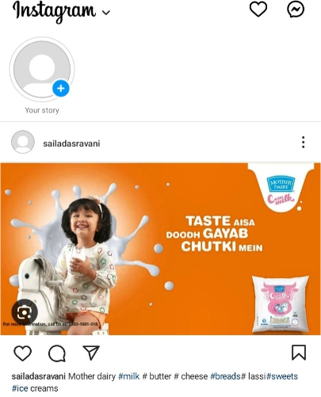

Recipe Videos
❖
Create short recipe videos
featuring Mother Dairy products as ingredients. For example, a 60-second video on "Creamy Paneer Tikka" using Mother Dairy paneer.
"Indulge in the goodness of fresh Mother Dairy paneer with our quick and delicious Paneer Tikka recipe. 😋🧀 Try it today!"
"Tag us when you recreate this recipe and stand a chance to win Mother Dairy goodies! #MotherDairyDelights".

Slide 41
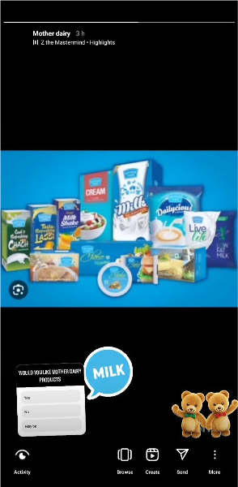

Customer Testimonials
❖
Share authentic
testimonials from satisfied customers who have experienced the quality of Mother Dairy products.
❖
"Our customers love Mother
Dairy's commitment to quality and freshness. Here's what they have to say about their favorite dairy brand!"
"Share your own #MotherDairyExperience and get featured on our page. Your love inspires us!"

Slide 42
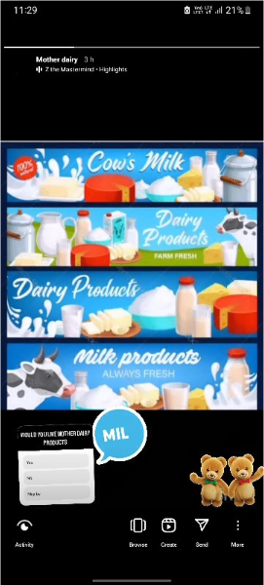
Educational Infographics
Content Idea: Create informative infographics about the benefits of consuming dairy products, highlighting the nutritional value of Mother Dairy items.
❖
"Know your dairy! Check out
these essential nutrients in Mother Dairy products. Stay healthy with every bite! 🥛
CTA: "Share this infographic to spread the goodness of dairy. #MotherDairyNutrition"
🧀"

Slide 43




❖
https: /www.instagram.com/s
/aGlnaGxpZ2h0OjE4MDQwMTk2NTA2NTU0MzQw?story_media_id=
3212749704169879855_62411694089&igshid=OGQ5ZDc2ODk2ZA==
❖
https: /instagram.com/sailadasravani?igshid= OGQ5ZDc2ODk2ZA==
❖
https: /www.instagram.com/s
/aGlnaGxpZ2h0OjE4MDQwMTk2NTA2NTU0MzQw?igshid=OGQ5ZDc2ODk2ZA==

Slide 44



Slide 45



Slide 46

Zoho Show
Untitled Presentation.pdf
(This PDF has been generated using Zoho Show)
To create beautiful presentations, download Zoho Show from Play Store https://zoho.to/cy7

